Slide 1
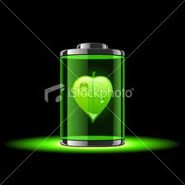
Bio battery
a fuel of next generation…..
Presented by-
Savitha s

Slide 2
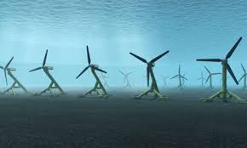
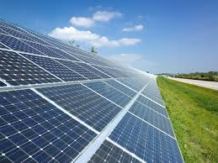
Present :
Presently we are using many types of energies.
Namely wind energy , solar energies , thermal energies.
In different technologies we use different types of batteries namely Lithium cadmium battery, Nickel battery etc.
Though we have many types of Batteries “BIO BATTERY” has many advantages over other and is also 100% eco friendly.

Slide 3
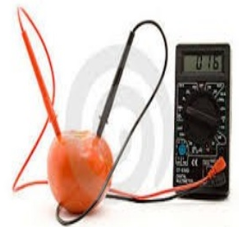
Bio battery
A bio-battery is an energy storage device that is powered by organic compounds usually being glucose such as glucose in human blood.

Slide 4
Bio-Battery generates electricity from renewable fuels (glucose, sucrose, fructose ,etc) providing a sustained, on-demand portable power source.
When enzymes in our bodies break down glucose, several electrons and protons are released.
Therefore, by using enzymes to breakdown glucose, bio-batteries directly receive energy from glucose.
These batteries then store this energy for later use.

Slide 5
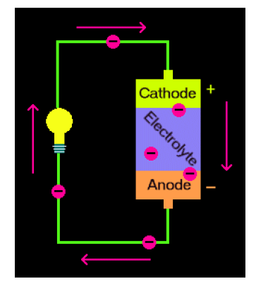
BIO BATTERY STRUCTURE
A Bio-Battery battery consists of two different metals suspended in an acidic solution.
They contain an anode, cathode, separator and electrolyte, which are the basic components to any cell battery.
Each component is layered on top of another component. Anodes and cathodes are the negative and positive areas on a battery.
The anode is located at the top of the battery and the cathode is located at the bottom of the battery

Slide 6
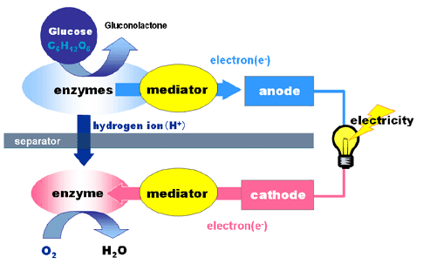
How it Works

Slide 7
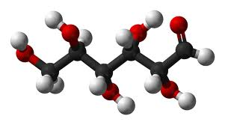
Glucose:
Bio batteries are heavily based on the amount of glucose available.
This glucose (sugar) can be provided from nearly anything, including soda, waste materials or the glucose in living organisms.
The decomposition of materials to glucose is the main step in getting the cycle started.
Once glucose is present, oxygen and other enzymes can act on it to further produce protons and electrons.

Slide 8
WORKING OF BIO BATTERY :
Glucose is broken down on the anode side of the battery producing protons (H+) and electrons (e-).
The protons (H+)are transferred to the cathode side through the separator, while the electrons (e-) are transported to the cathode side through the mediator, which transfers them to the external circuit.
Between the anode and the cathode lies the electrolyte which contains a separator.
The main function of the separator is to keep the cathode and anode separated, to avoid electrical short circuits. This system as a whole, allows for a flow of protons (H+) and electrons (e-) which ultimately generate electricity.

Slide 9
Types of bio battery
Passive system type
A system in which reactive substances are absorbed in to the electrodes through a process of natural diffusion.
Active system type
In this type the reactive substance are introduced by force by technique as string ,convection.

Slide 10
Need of Bio-Battery
An electricity shortage is felt most by those who depend on electricity for heating, cooking, and water supply.
In these circumstances, a sustained energy crisis may become a humanitarian crisis.
As it is known that the energy conservation is the major issue these times so the bio-battery is one of the energy conservation method.
It can save a lot of power and it is also energy efficient phenomenon.
Bio-Battery is a renewable energy source which is again the major requirement of current energy system.

Slide 11
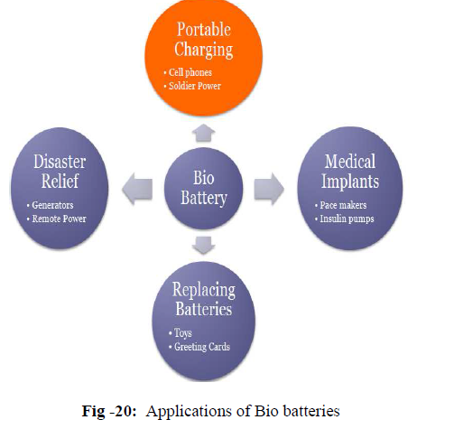
Applications:
Medical implants like pace makers,insulin pumps
Disaster relief
Replacing batteries in toys and greeting cards
Portable charging in cell phones
Bio battery music playback with memory type walkman

Slide 12
Sony successfully demonstrated bio battery powered music playback with a memory type Walkman and passive speakers (which operate on power supplied by the Walkman) by connecting four bio battery units in series.
The case of this bio battery, which is made from an organic plastic (polylactate), is designed to be reminiscent of a living cell.

Slide 13
Advantages:
Instant recharge
Eco friendly
Raw materials available easily & plenty
Portable & light weight compared to fuel cell.
Provide a better employment scope for rural areas.
readily available fuel source.

Slide 14
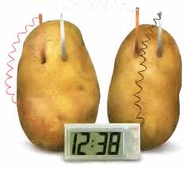
Disadvantages:
Compared to conventional batteries, such as lithium batteries, bio-batteries are less likely to retain most of their energy.
This causes a problem when it comes to long term usage and storage of energy for these batteries.
However, researchers are continuing to develop the battery in order to make it a more practical replacement for current batteries and sources of energy.

Slide 15
Conclusion
The Bio batteries are High performing, temperature stable.
Bio battery the small, flexible, and environmentally friendly battery technologies discussed here show the great possibilities researchers see in bio-batteries, especially for the field of medicine.
This causes a problem when it comes to long term usage and storage of energy for these batteries. However, researchers are continuing to develop the battery in order to make it a more practical replacement for current batteries and sources of energy.

Slide 16
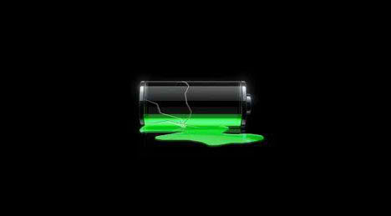
Thank you

